Slide 1
Color Theory
2D Fall 2016

Slide 2
Primary Colors
Colors that make all of the colors
You cannot make these colors
The colors are:
Red Yellow Blue

Slide 3
Secondary Colors
Colors made by mixing primary colors
Green Orange Violet

Slide 4
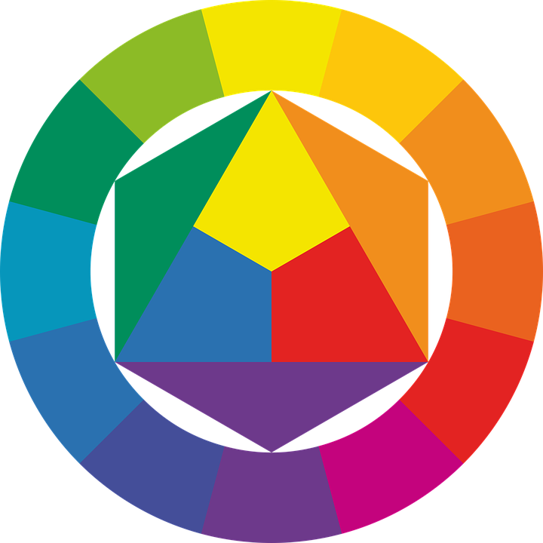
Intermediate/Tertiary Colors
Colors made by mixing primary and secondary colors.
Red-Orange,
Yellow- Orange,
Yellow-Green,
Blue-Green,
Blue-Violet,
Red-Violet

Slide 5
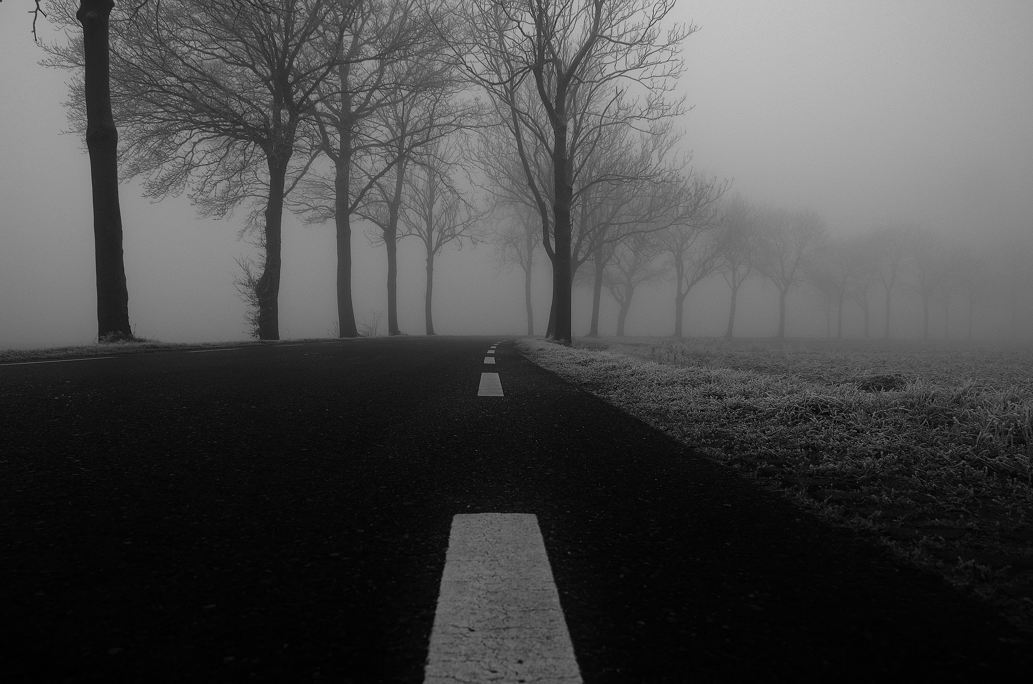
Neutrals
Colors not on the color Wheel.
Black
Gray
White
Brown
Beige
*Sometimes Called Earth Tones

Slide 6
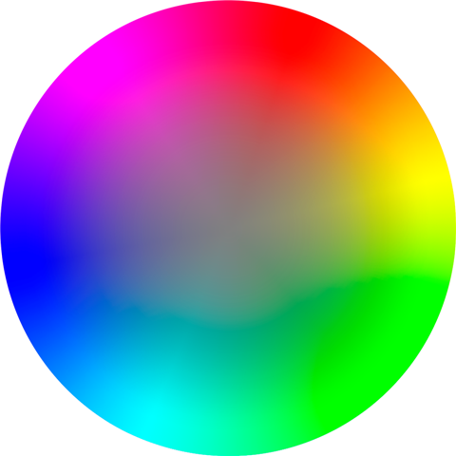
Hue: Another name for color
Chroma: Range of color

Slide 7
Value
Lightness and darkness of a color (adding black or white)

Slide 8
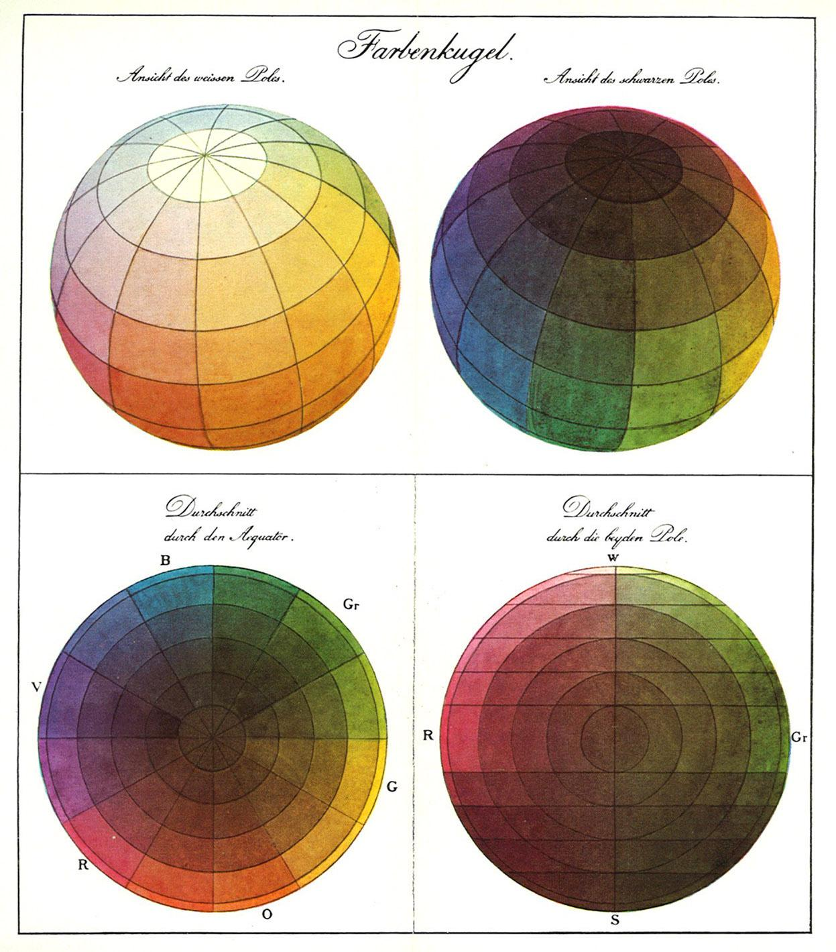
Intensity
Brightness or Dullness of a color (adding another color)

Slide 9
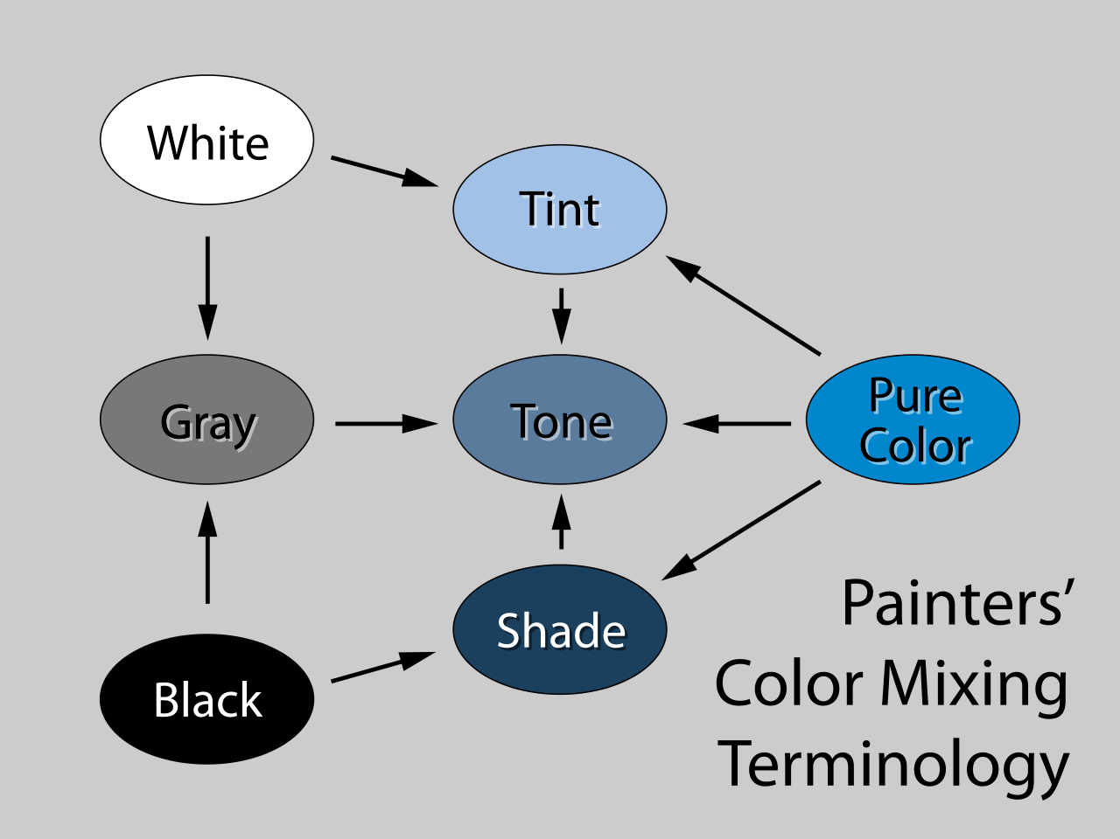
Tint, Shade & Tone
Tint: adding white to a color
Shade: adding black to a color
Tone: adding gray to a color

Slide 10
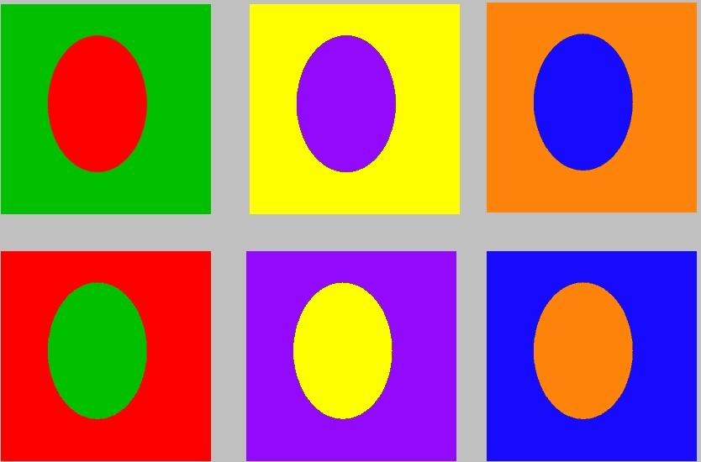
Color Schemes
Complementary colors: Colors that are opposite on the color wheel.
Yelllow and Violet, Red and Green, Orange and Blue

Slide 11
Color Schemes
Monochromatic: All one color plus its tints and shades
(add white and black)

Slide 12
Color Schemes
Triadic: Colors making a perfect triangle on the color wheel.
Example: Pick one color, skip three = Red, Blue, Yellow
Analogous: Three to Five adjacent colors on the color wheel.
Example: Yellow, Yellow-Green, Green, Blue Green, and Blue

Slide 13
Warm Colors
Ex:Red, Orange, Yellow
Think of Summer
Cool Colors:
Ex: Violet, Blue, Green
Think of Winter

